Slide 1

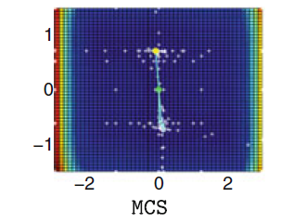
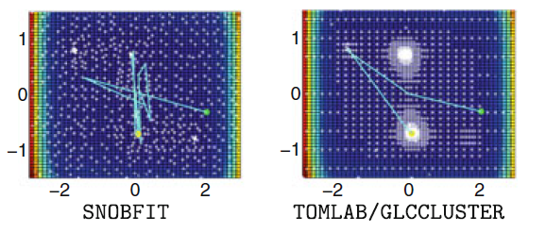
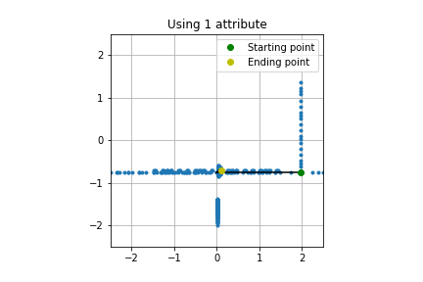
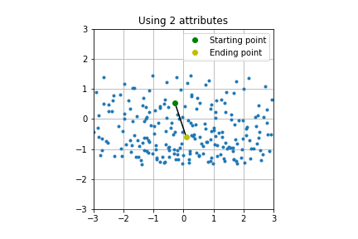
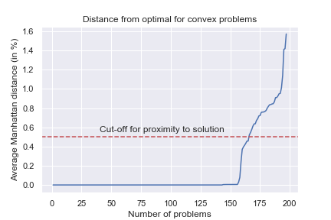
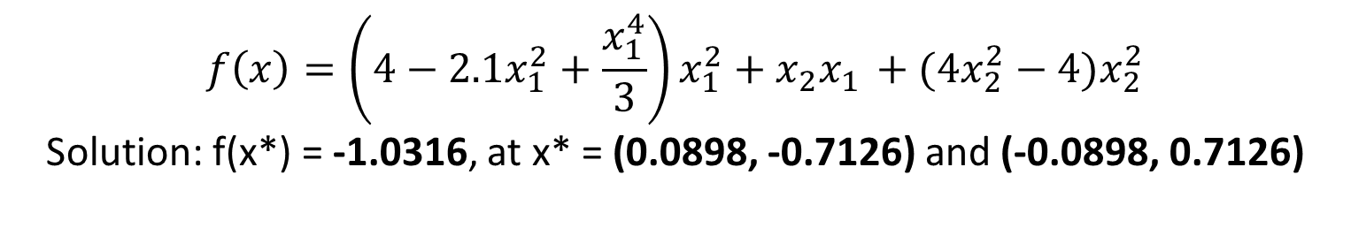
Black-Box Optimization using block-coordinate approach on a Surrogate model
Kanishk Mair, Nikolaos Sahinidis, Jonggeol Na, Nikolaos Ploskas
Introduction
Algorithm
Simulation results on Camel6 problem
Background
Black-box optimization problems arise in areas such as logistics, engineering design, energy generation, etc.
These problems are in general computationally expensive and NP-hard and hence difficult to solve for global optima.
Various algorithmic implementations exist whose success rate of finding global optima depend on convexity and smoothness of the function.
Problem Statement
$$f\left(x\right)=\left(4−2.1x_{1}^{2}+\frac{x_{1}^{4}}{3}\right)x_{1}^{2}+{x_{2}x}_{1 }+(4x_{2}^{2}−4)x_{2}^{2}$$
Solution: f(x*) = -1.0316, at x* = (0.0898, -0.7126) and (-0.0898, 0.7126)
Until Termination Criteria
Select a Starting point X^{SP}
Displaying the Implementation on most successful solvers
For ‘N’ epochs
To improve modeling by ALAMO, after each epoch, the variables in a block are grouped based on variables with similar steepness
Based on literature, the below three solvers can solve to get best results in most of the cases
Applying block coordinate descent on X*
Carry out Derivative-Free Optimization (DFO) of the problem library
Achieve the best solution while limiting the maximum number of function evaluations to 2500.
Obtain an algorithm to optimize black-box models with high degrees of freedom.
Add Nesterov’s momentum to X* and do sampling
Fit model using ALAMO and find the best point
NO
Update parameters and move to next block
Resample additional points
New point X^{opt} better than X*
NO
Patience factor terminated
Displaying the Implementation of present algorithm
Using 1 and 2 attributes respectively for the block coordinate descent, the algorithm uses SOBOL sampling for modeling the surrogate function
Black-box Optimization
YES
YES
Sampling Methods
Selection of sampling points has an immense impact on the fitness of the surrogate model.
The quasi-random numbers have an advantage over pure random numbers can cover the domain of interest quickly and evenly.
Thus, the usage of quasi-random low-discrepancy sequences improves the convergence of the model.
Sampling techniques used:
Set X* = X^{opt}
Record local optima and move to next X^{SP}
Movement of Points
The algorithm progresses to the new point if we obtain better value either in samples or by minimizing the surrogate model (1) and reduce the search domain
If an iteration gives worse value (2), the point stays at the same location (3) until the patience limit is reached
This greedy search is necessary since the Nesterov’s momentum term can drive the solution away from the optimum (local or global)
Instead greater number of samples are collected in a larger domain for getting improved model fit
1
2
Conclusion
SOBOL sampling
Latin hypercube
Hammersley
3
The algorithm was able to reach near global optimal solutions for several convex and non-convex problems with less attributes as soon as the first momentum term was added. Thus, adding the second moment term can further improve the convergence.
The sampling region reduces as we move towards the optimal which leads to improved modeling but leads to premature convergence to local optima.
The convergence to a solution depends heavily on the starting point, so building a global model based on evaluated points can further help in selecting the next iteration point.
Carrying out further experiments can help in setting better hyper-parameter values.
Example of iterative movement of points
Modeling Surrogate Function
Advantage of using ALAMO:
Convergence for convex problems
Requires lesser number of sampling points
Flexibility with respect to type of function
Generates simple and accurate models
Carries out adaptive sampling by error maximization
ALAMO
Linear
Polynomial
Exponential
Trigonometric
An average of Manhattan distance based on domain range was selected to check proximity to the global optima.
If the solution was within 0.5% proximity to the solution, the model can reach the optimal point if re-initialized from that point.
The algorithm’s convergence is similar for smooth as well as non-smooth problems since it doesn’t use the derivative.
Future Work
Parameters and Hyper-parameters
At present, only momentum factor is accounted. But if the model can utilize derivatives, then using the Hessian, we can implement learning algorithm inspired by ADAM.
Owing to the presence of multiple hyper-parameters, the algorithm relies on quasi-random sampling methods. Utilization of adaptive sampling within ALAMO can improve the modeling and expedite in escaping the local optima.
Number of sampling points (N^{SP})
Scaling factor (sf)
Number of attributes in a block (n)
Patience factor
Sampling technique
Type of surrogate function
Maximum epochs
Tolerance limit
Also, the momentum term helps the point to move even in non-smooth problems.
About 25% of the problems reach global optima, while the rest reach close to the solution

